Slide 1
Ames Housing
Research Report
By J.S. Consultancy LLP
Notes:
Tuesday drafting slides
Friday Slide finalization

Slide 2
Agenda
Background
Problem Statement
Methodology
Recommendations
Conclusion

Slide 3
Some background...
J.S. Consultancy LLP specialises in real estate consultancy services in the United States (the U.S.). We are committed to provide quality advisory services and provision of independent market research related to the real estate industry where we have significant expertise.
Iowa Real Estate (IRE) marketing team has engaged our dedicated consultants to aid in its expansion of its services into Ames, Iowa.
482
275
A
B
C
D
E
F

Slide 4
Our Problem Statement
As part of our agreement, our points of focus are as follows:
To predict the sale price of the houses in Ames;
To identify the neighborhood in Ames that commands the highest sale price of housing;
To recommend features that would lead to the greatest fluctuation in sale prices of the houses.
Our engagement has concluded as of 13 May 2021 and we are pleased to present our findings:
Methodology
House Prediction Model
Recommendations of neighbourhood and features to focus on

Slide 5
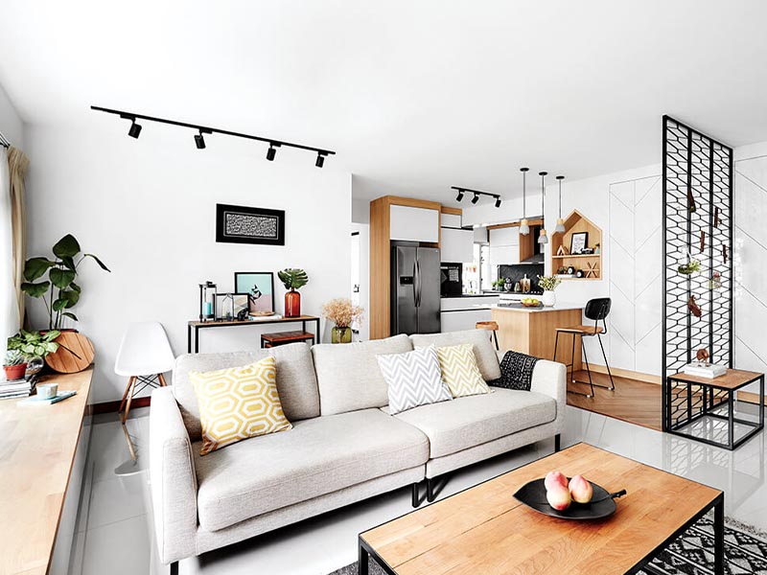
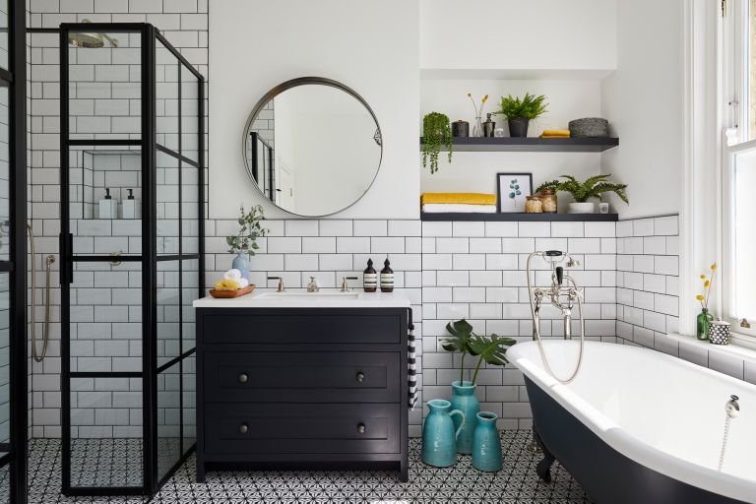
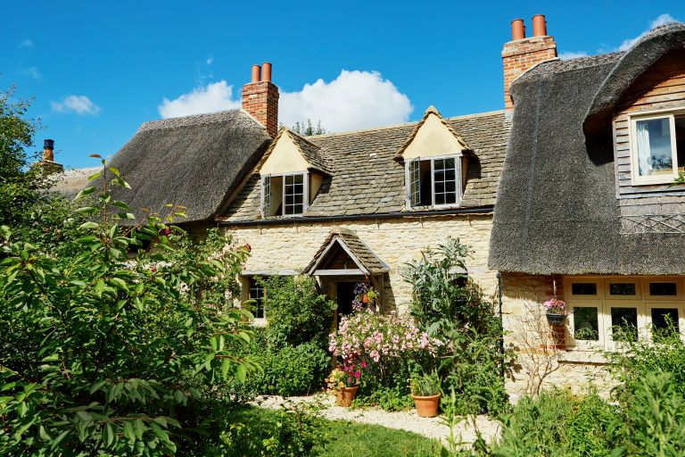

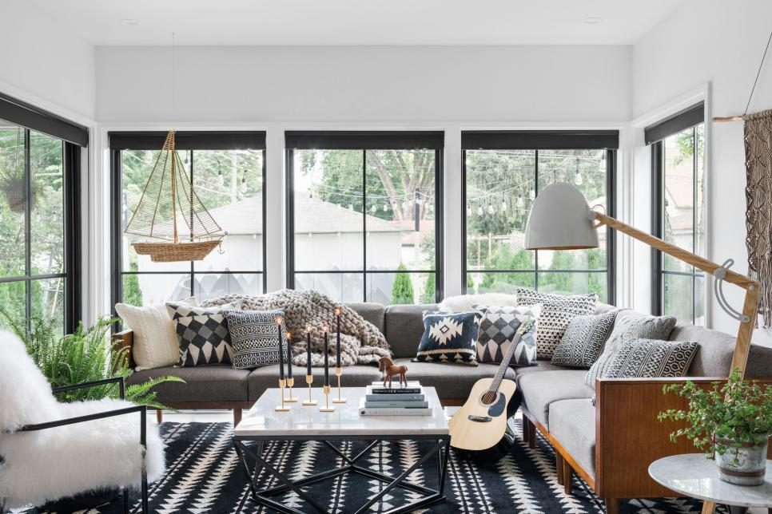
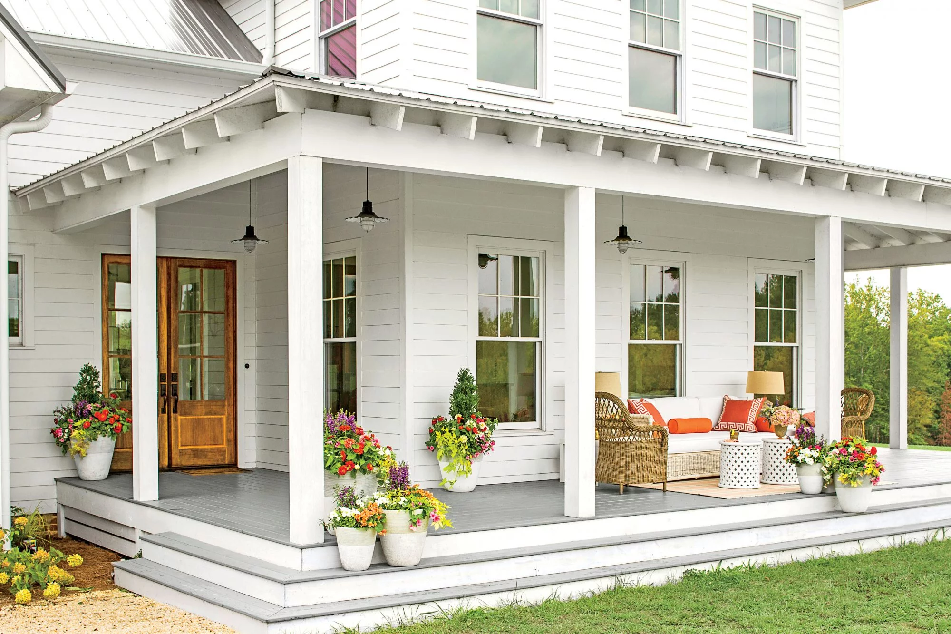
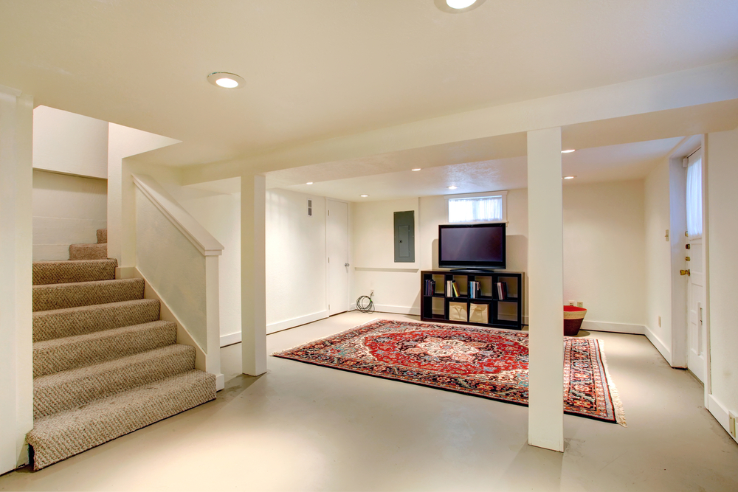
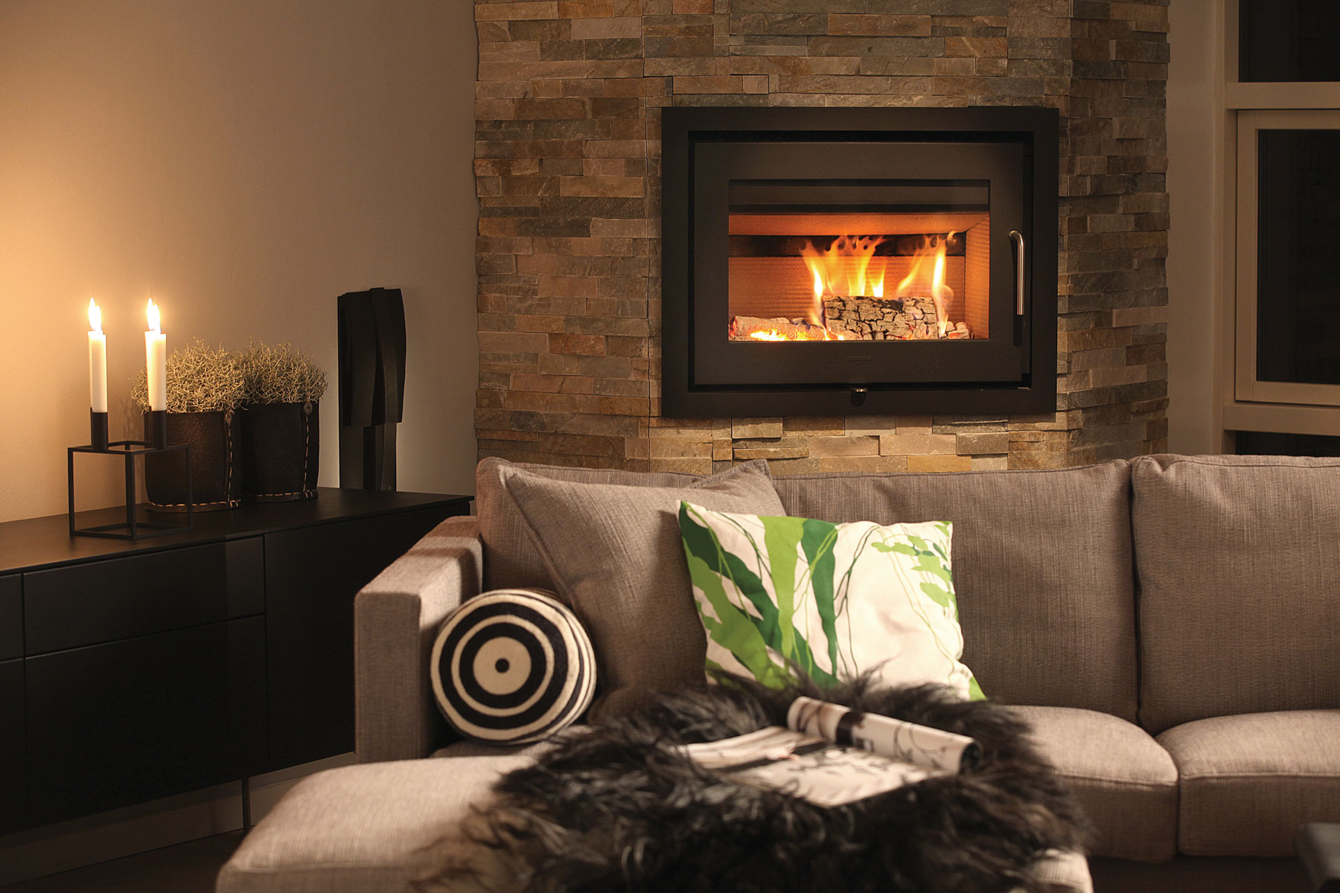
What do you think are some features used to predict housing price?
Living Area No. of Bathrooms Age of house Neighborhood
Overall Quality Presence of porch Presence of basement Type of heating

Slide 6
Our Methodology
Data Gathering
Data Cleansing
Modeling
Evaluation
- Source: Ames, Iowa Assessor’s Office - 82 features - 3K properties
- Handling missing data - Removing outliers - Featuring engineering
- Defining a baseline - Train, test, and refine our final model
- Recommendations on neighborhoods and features

Slide 7
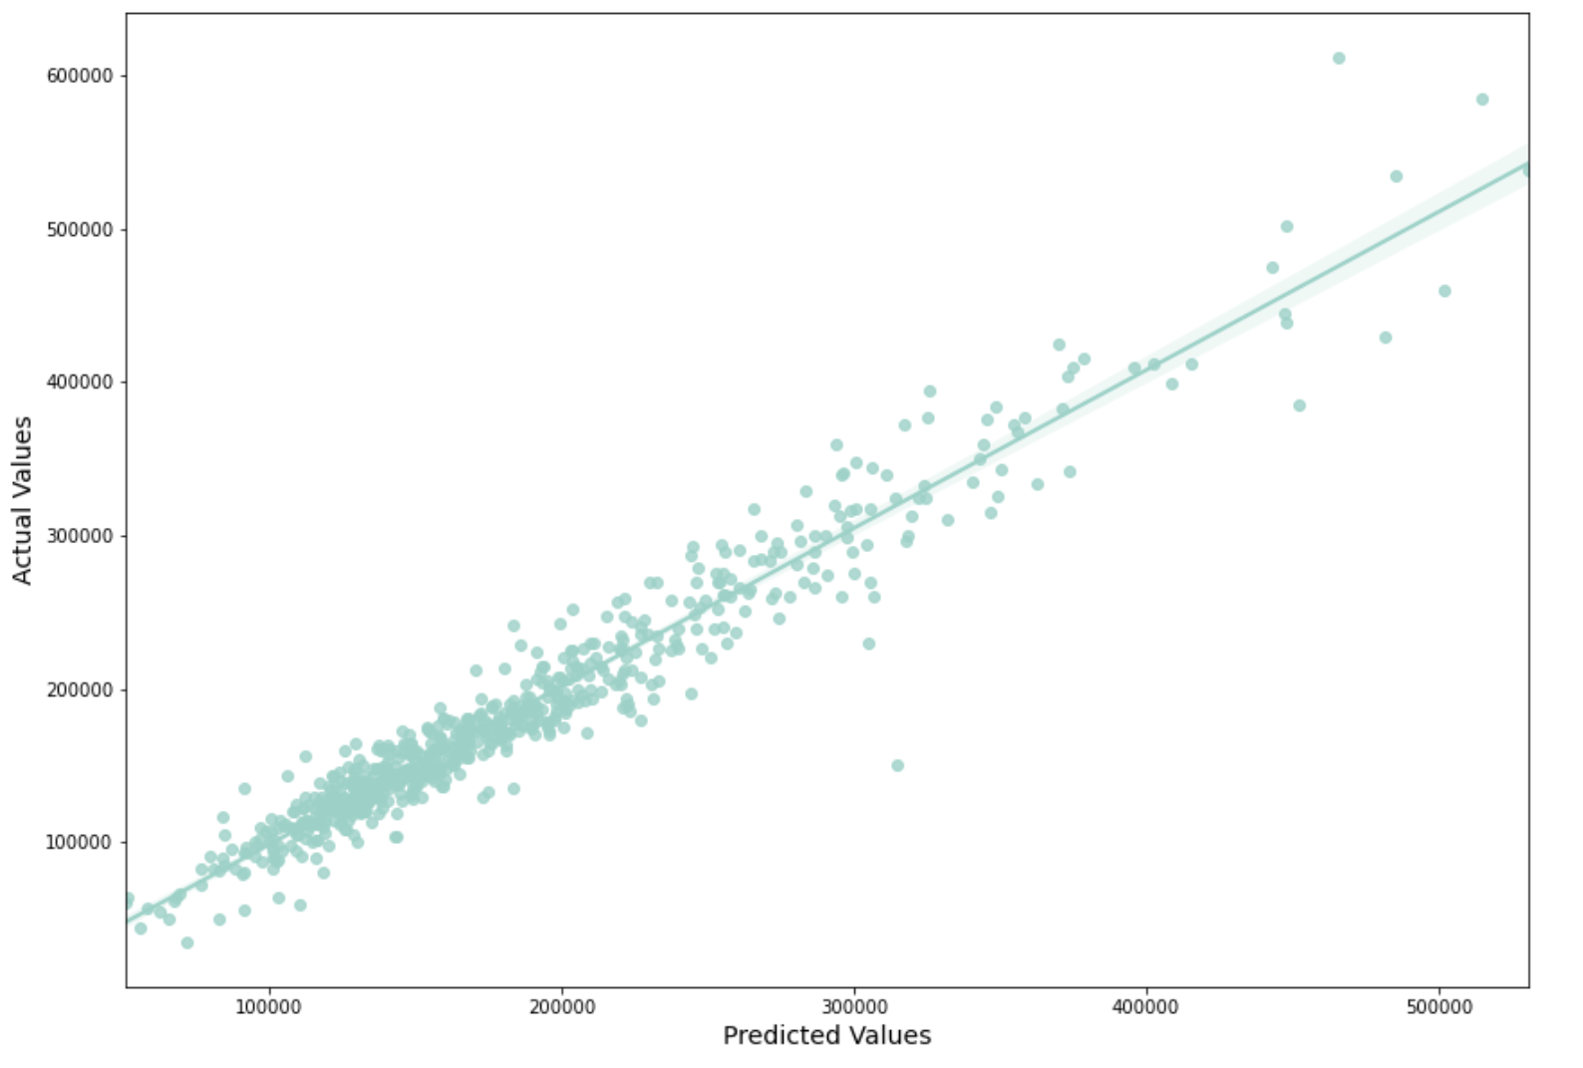
Our House Prediction Model
20K USD
Root Mean Square Error
92.4%
R2 Score
Notes:
Average house price in our test set is 183K USD. Our model has a root mean square error of 20K USD, meaning that on average our predictions differ from the actual sale prices by 20k USD. For reference, if we were to use the average house price to predict house prices the RMSE would be 56k

Slide 8
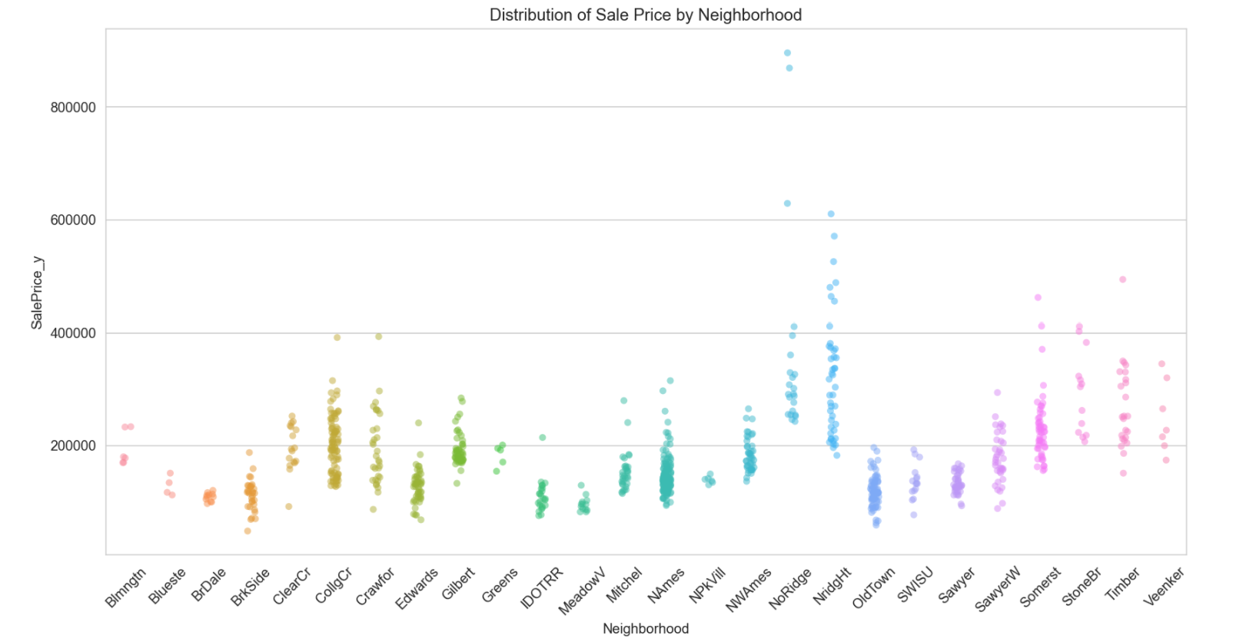
Our recommendations for the top neighborhoods are...
The top 5 neighborhoods that command the highest sale price of houses include:
Northridge
Northridge Heights
Stone Brook
Timberland
Veenker

Slide 9
Our recommendations for the top features are...
For every unit increase in the following features, the expected fluctuations in sale prices are:
+ 12K USD
+ 35 USD
+ 22 USD
- 83 USD
- 295 USD
Overall Quality
Above Grade (Ground) Living Area (in square feet)
Total Basement (in square feet)
Age of Remodelling/Addition
Age of House

Slide 10
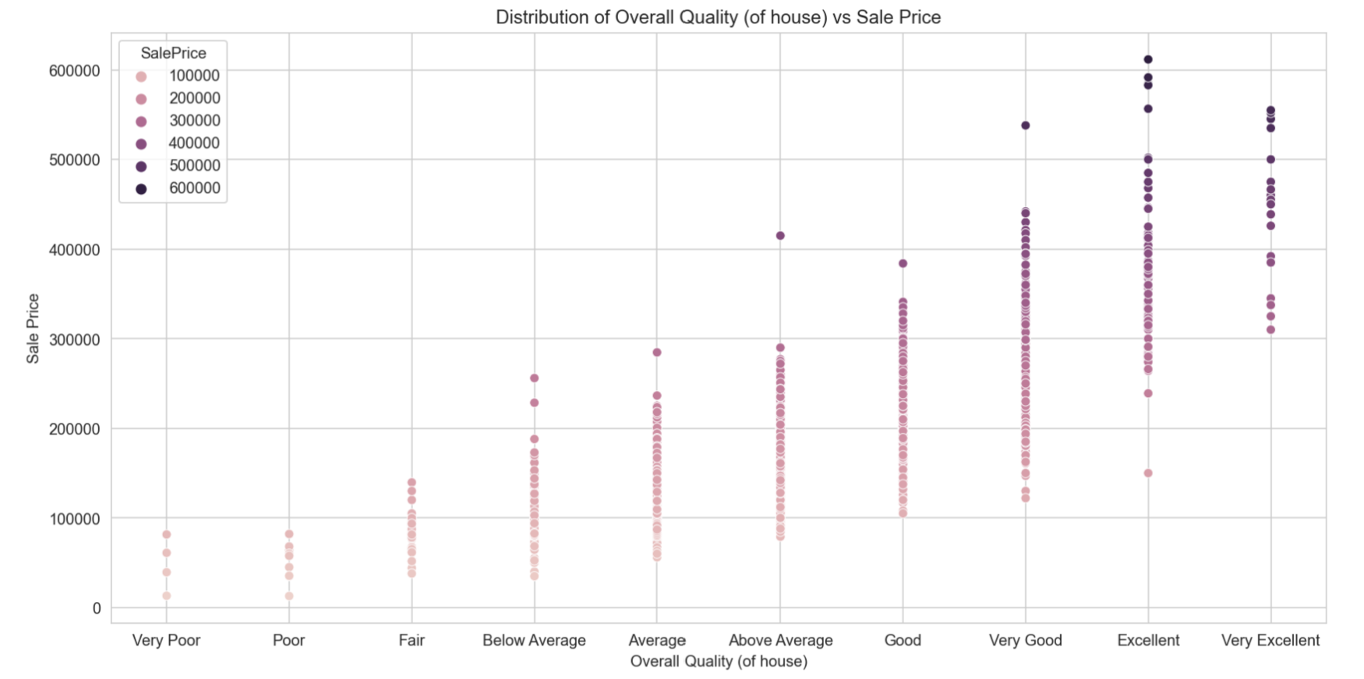
Feature 1: Overall Quality
For every unit increase in Overall Quality, the mean sale price will increase by 12K USD.
Aspects to consider:
Materials used to construct the house;
Able to handle effects of climate change.

Slide 11
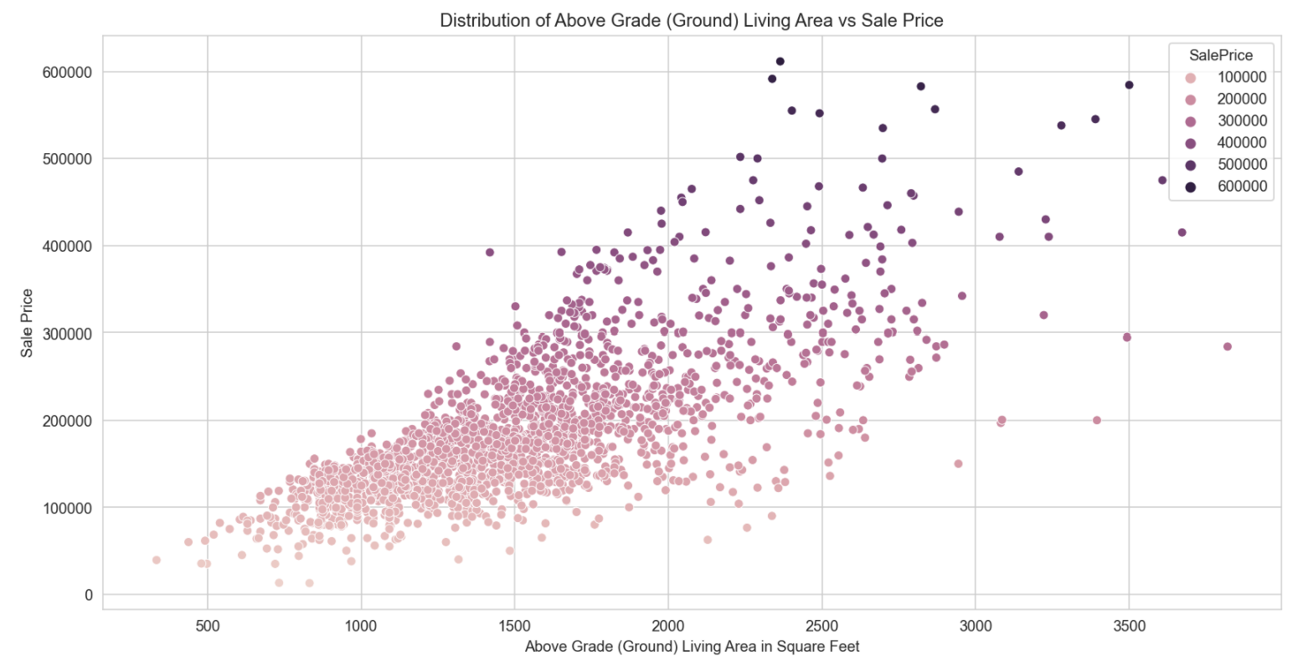
Feature 2: Above Grade (Ground) Living Area
For every unit increase in above grade (ground) living area (in square feet), the mean sale price will increase by 35 USD.
Aspects to consider:
Interior design and furnishing;
Unused garage space converted into living space.

Slide 12
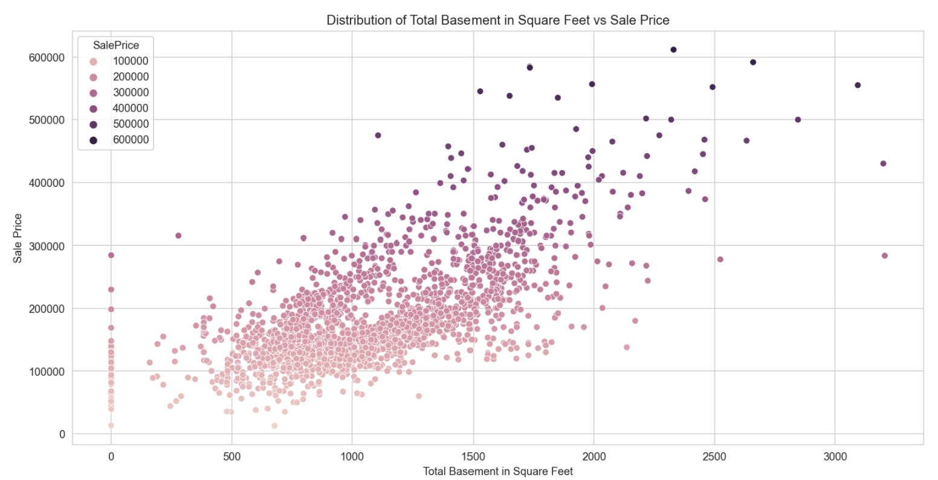
Feature 3: Total Basement (in sq ft)
For every unit increase in total basement (in square feet), the mean sale price will increase by 22 USD.
Aspects to consider:
Identify houses with basements, i.e. those that have been converted into recreational space / indoor gym.
Source: The Balance Small Business, 2019 (https://www.thebalancesmb.com/pros-of-finishing-a-basement-for-property-investors-2124861)

Slide 13
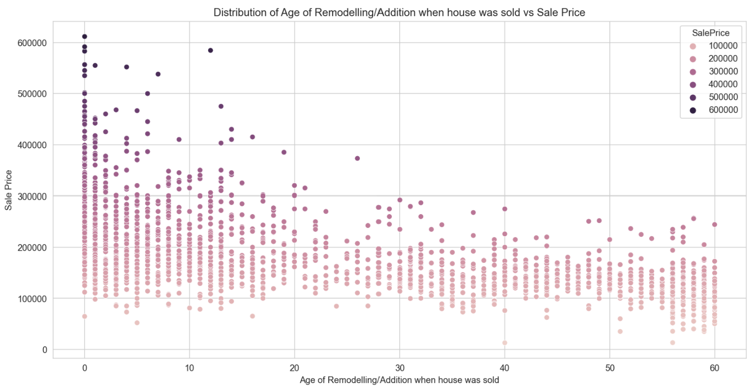
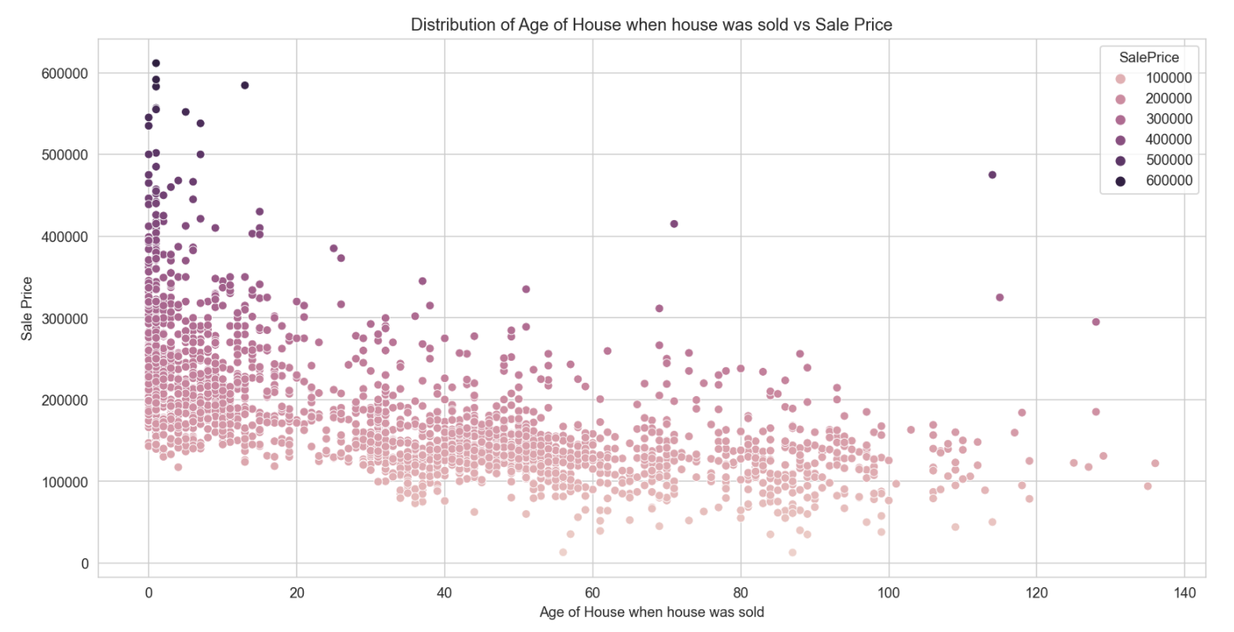
Features 4 & 5: Age of Remodelling; Age of House
For every unit increase in age of remodelling/addition in the house, the mean sale price will decrease by 83 USD.
For every unit increase in age of the house, the mean sale price will decrease by 295 USD.
Aspects to consider:
Renovations done to give the interior and exterior of the house a new look;
Damages, i.e. leaking water pipes, have been fixed.

Slide 14
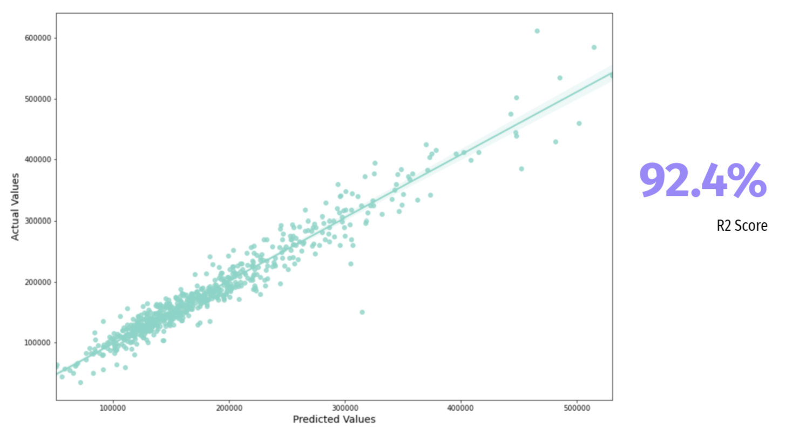
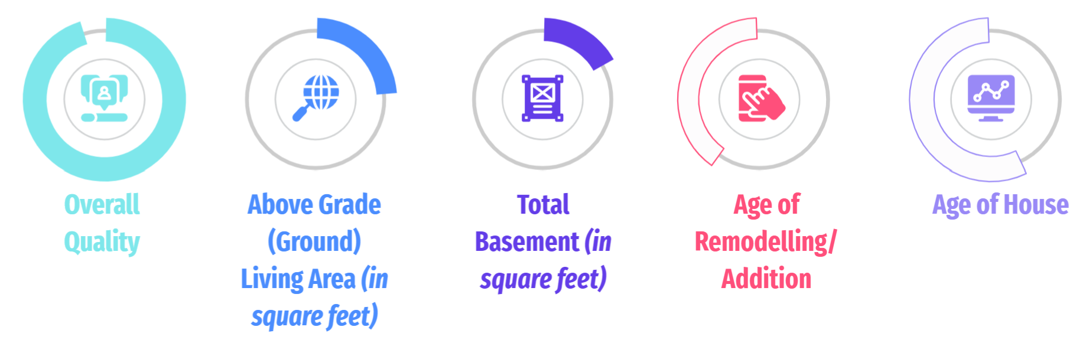
Conclusion
Our House Prediction Model
Top 5 neighborhoods that command the highest sale price of houses:
Northridge
Northridge Heights
Stone Brook
Timberland
Veenker
Top 5 features that result in the greatest fluctuation in sale price of houses:

Slide 15
THANK YOU :)
By J.S. Consultancy LLP
Notes:
Tuesday drafting slides
Friday Slide finalization

